Slide 1
Unit Test with Pytest

Slide 2
What is pytest?
Open-source Python testing framework
Not part of Python standard library
Active since 2007 and arguably most popular testing framework in Python

Slide 3
Key points about learning pytest
How to write test cases
How pytest determines if a test case passes/fails
How to choose what test cases to run or not to run

Slide 4
assert keyword: basis of unit test
assert takes any expression. If the expression returns:
True: do nothing
False: throw AssertionError
Exercise: try assert in python interpreter

Slide 5
One test case in one file
# content of test_sample.py
def inc(x):
return x + 1
def test_case_1():
assert inc(3) == 5
Exercise:
Go to ex1 folder
pytest
pytest -v

Slide 6
How are tests discovered? (1/2)
If you type and run pytest without arguments:
Collection starts from the current directory.
Recurse into directories
In those directories, search for
test_*.py
*_test.py
From those files, collect test items:
test prefixed test functions

Slide 7
Multiple test cases in multiple files
Exercise:
Go to ex2 folder
App code to be tested resides in my_app.py
Check out the 2 test sample files.
Add one more test file with your test cases.
See how pytest and pytest –v discover your test cases

Slide 8
Expect exceptions
To assert that a code block/function call raises expected_exception or raise a failure exception otherwise.
Exercise:
Go to ex3 folder
Add a function that
returns absolute value of a negative input value;
If input value is positive, raise ValueError.

Slide 9
Run specific tests
pytest test_sample_2.py
pytest test_sample_2.py::test_case_2
pytest test_sample_2.py -k important_case
Exercise:
Go to ex2 folder
Try the above 3

Slide 10
Run tests by folders
Exercise:
Go to tests folder
Run the following:
pytest
pytest ex1
pytest ex2
pytest ex2 ex3

Slide 11
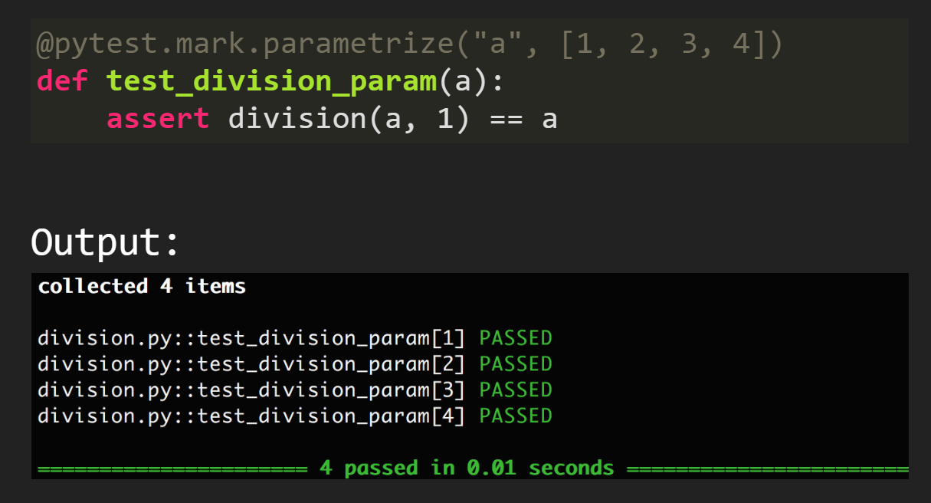
Parameterized test cases
Exercise:
Go to ex4 folder
Try the above 3

Slide 12
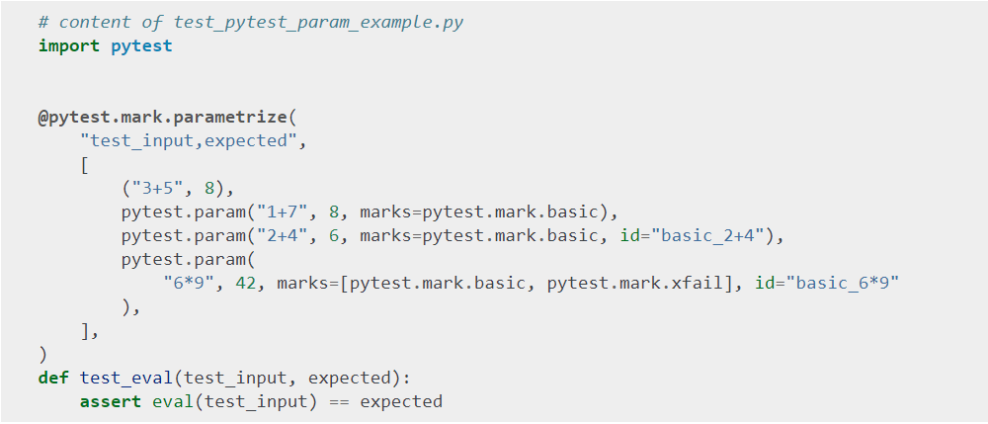
Marked test cases
Exercise:
Go to ex5 folder
pytest –v
pytest –v –m basic

Slide 13
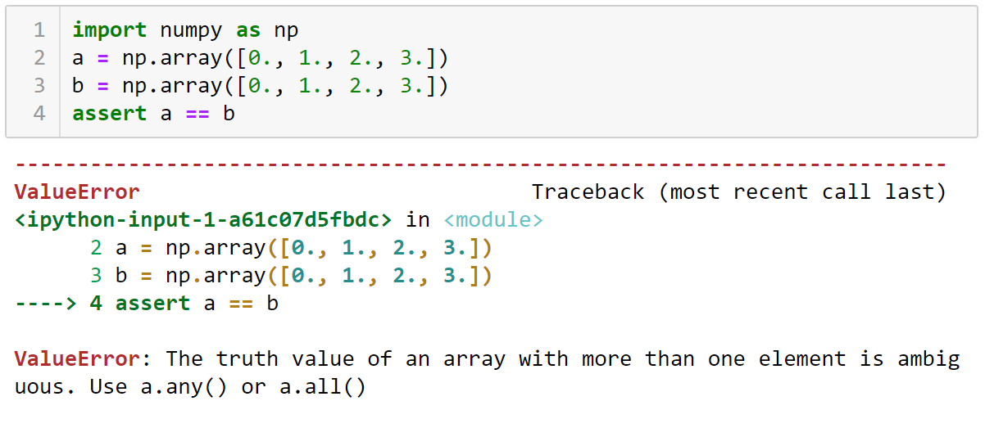
Testing with Numpy (1/2)
Simple assert statement is not useful for numpy.
Where does this ValueError come from?

Slide 14
Testing with Numpy (2/2)
NumPy has an entire module devoted to testing support. Some functions from the module are useful, as they provide consistent behavior and compatible with pytest. For example:
assert_array_equal
assert_allclose.
Exercise:
Go to ex6 folder
pytest –v test_file_1.py
pytest –v test_file_2.py
pytest –v test_file_3.py

Slide 15
Testing with Pandas DataFrame
Likewise, simple assert statement does not work work well with dataframes. Pandas has its own testing module:
assert_frame_equal
assert_series_equal
Exercise:
Go to ex7 folder
pytest –v test_file_1.py
pytest –v test_file_2.py

